Slide 1
Requiem Registry
Cook, Gamboa, Hicks

Slide 2
Introduction
A real problem
Mallory’s Cemetery record keeping system
Paper spreadsheets of persons’ names and plots
Redundant copies
Names added manually
Our solution
A digital database for the dead with additional features
Accessible via the web
Public page for searching the dead
Can be used for multiple cemeteries
Notes:
A Real Problem: The idea for our project came from seeing how the Mallorys Cemetery in Chapmansboro keeps their records. Each staff member keeps a copy of the record for the dead, which is just a large piece of paper with the name of all people buried there. Anytime a new person is buried, all the staff have to pen in the new name for their copy. This redundancy increases the chance for human error. Our Solution: We figured this was problem that could be solved by moving the records into a digital database, but since we don’t want this capstone to be easy for us, their be some added features. To start off, we’re making this project web-based, so the public can look up who’s buried where. And the “where” won’t just be plot numbers, cause this database will also keep record for multiple cemeteries.

Slide 3
User
Controlling privileges
Two types of users
Administrator user
Login via Google account
Access to writing privileges
General user
No login
Read only access
Notes:
Controlling privileges: Requiem Registry will be accessible by both the public and the staff running it, but to avoid unauthorized access, this division will be implemented with the definition of two kinds of users. Administrator User: Admin users will be required to login via their Google account. Admin users will have the privilege to edit info on the website. General User: Anyone that can access the website via URL is general user no need for login credentials

Slide 4
Main Page
The website’s home page
Show selected cemetery’s info
Name
Description
Address
Cemetery drop-down menu
Selection will update cemetery info shown
Deceased search bar
Successful search will bring up a page for that specific person.
Notes:
Main Page: This is the website’s home page and will be the first thing the public sees. Here, information for the Cemetery currently selected will be visible, this include its name, a description, and its address.
Cemetery drop-down menu: The selected cemetery can be changed with the use of a drop-down menu on the page, which will also update the cemetery information.
Person search bar: Changing cemeteries will also affect who can be found with the main page’s search bar, which is the tool users will use to look up those buried in the cemetery. Our plan is that queries with only one exact match will load that person’s page, while queries with multiple matches will show a list of those results.

Slide 5
Administrator Page
Admin Page with the following sub pages:
Cemetery Page
Add, edit, delete cemeteries
Person Page
Add, edit, delete people to database
Plot Page
A list view of plots.
Map Page
Google Maps API to allow points to be set on plots
Notes:
Admin page will have a navigation bar or a sub menu on the left side of the screen.
When the admin successfully logs in, it will look just like main page, but that navigation bar will appear on the left.
This will serve as the admin hub => then there will be the 4 options listed, each of these will come up in place of where the home page was
Nav Bar will stay so user can quickly switch pages
Cemetery - list of cemeteries, add, edit each one, each cemetery will have a name, description, address, and capacity.
Person - This will be a list of people and is where managing people will take place. Adding people with their info, as well as editing or remove people.
Plot- This will just be a simplified view of the plots and person that is associated with it.
Map- This is where the user will add plots to the map, then once a plot is added connect a person object to the plot
Plot page servers as a more streamline view of plots if the map is not preferred by user.

Slide 6
Cemetery Page
The page for managing Requiem Registry’s cemeteries
Functions
Add cemetery
Update cemetery
Remove cemetery
Each cemetery as a name, description, capacity, and address
Notes:
Requiem Registry can keep records for plots of multiple cemeteries. With that in mind, this page will be where the admin can add new cemeteries,
Information stored for each cemetery will include its name, an optional description, its current number of plots it has (which is called its capacity), and its address.
update the information of existing cemeteries,
and even remove cemeteries from the database.
This information will come into play with the main user page - plots page - and map
The users will select which cemetery to see or edit if they are admin
The cemetery page will be the first time in the user flow of the program. That’s why it will be the first option on the navigation bar

Slide 7
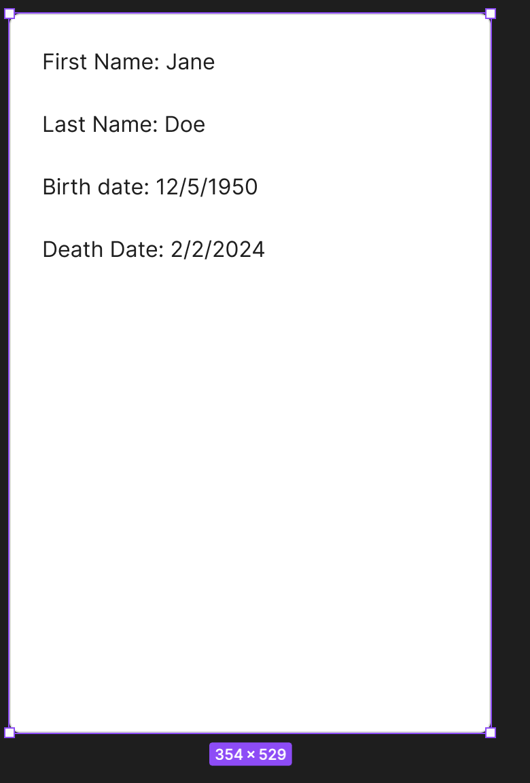
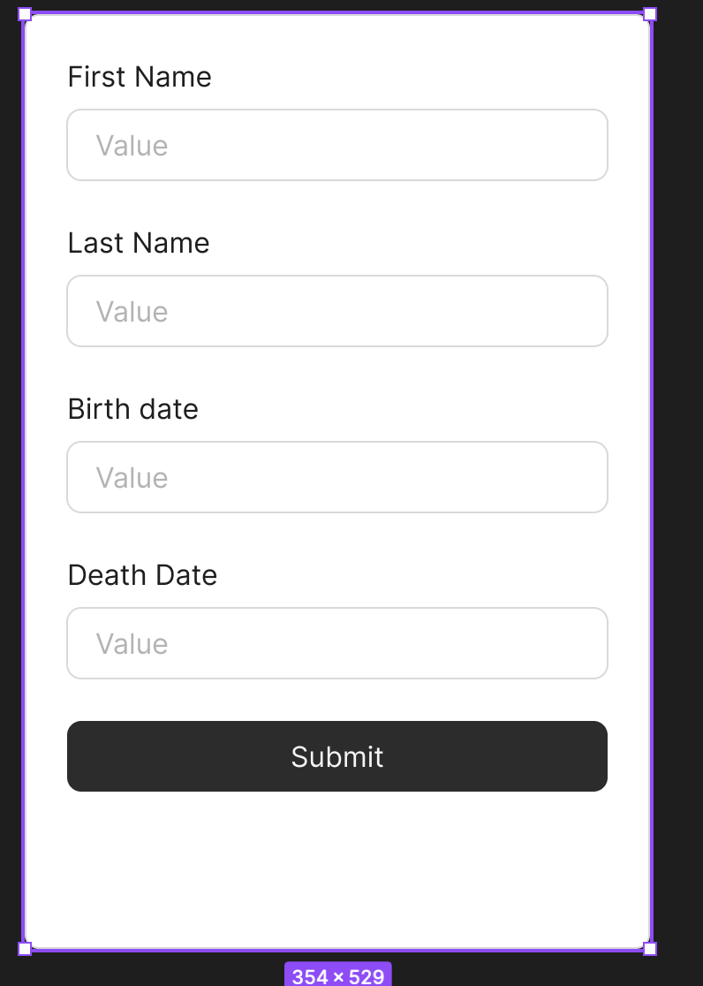
Person Page
Contains a person’s information
Name
Date of birth
Date of death
Plot number
Utilized by both types of users
Admin can edit person information
Users can only view the person information
Notes:
Person Page: This is where a person’s information can be found. This includes their first and last Name, Date of birth, Date of death, and number of the plot they are associated with.
There will also be entry for middle name and suffix if applicable.
This page will be utilized by both types of users, with the Administrator having the ability to edit the data, and the general user only being able to view the data.
The pictures are just a quick example i put together in figma to show that there are two different privilege levels with person data. Read only for general user - read write for admin user
Person Info :
Adding, Editing, and Deleting people from data base.
These functionalities will only be accessible in the person page.
This information will appear all throughout website, the map will have a pop up with person info, the main page will show person page information on successful search and plots page will show person info associated to plot.
There will be a search bar at the top of this page so the admin can search for a person in list.

Slide 8
Plot Page
This will be a list of the plots.
The list will show a brief description of the person that is associated to the plot if applicable.
Notes:
The plot list will serve as a way to quickly see what plots you have.
There will be a drop down choice box - this will include cemeteries in database, once the user makes selection the plots associated with that cemetery will be seen in the list
This list will have a search bar to quickly find a plot of you know it number or information on the person assigned to it.
The point of this page is to have a list for data, in comparison to a map.
There will not be a way to edit plots on this page, the sole purpose of this is to VIEW the data.

Slide 9
Map Page
Adding plots
Button to add plots to map. The admin will click where they would like the plot to be and that point on the map will now be associated to a new plot.
The plot number will be auto generated by the database.
Clicking on a plot to connect people to plots
Once a plot is added to the map, the plot can be connected to a person.
The plot will give the user a pop up window
The window will allow the user to select a person to add to plot.
If the plot already has a person associated with it, the user can remove the person, or replace the person with someone else.
Notes:
Map page will be where users connect person objects to plot objects.
The map will need the user to add plots to the map - this can be achieved by pressing add plot button then moving mouse over map where the plot should be located and clicking
The UI will then display a plot on the map
If the user clicks that plot then a pop up window will appear - the pop up window will show a list of the people in the database - the user can select a name to connect the person with that plot
If a plot already has a person, the user can change it to a different person, or just remove the person to make the plot empty.
When viewing the map, clicking on the plot will show a popup of the person information associated - if the user wants to see more on the person they can click at the bottom of pop up a link to direct them to the person page
This will be an option that way if you miss clicked you aren’t having to navigate pages too
For reference as to why moving people from plots is necessary - sometimes people will purchase multiple plots for family, or purchase a plot and end up selling it. Therefore we need the ability to switch names on plots is vital

Slide 10
Interesting Risky Difficult Requirements
Maps Plot Markers (Interesting & Difficult)
Visualize plot locations on the map
Add new plots to map with point & click feature
Unfamiliarity with Google Maps API
Notes:
Google Maps Plot Markers: The idea is that using Google Maps API we can drop points based on plot location and tie that to the person info corresponding with the plot.

Slide 11
Interesting Risky Difficult Requirements
Editing Database info (Difficult & Risky)
Making sure to accurately implement CRUD.
Editing data will introduce concern with making sure updates reach database correctly.
Notes:
Editing Database info: Editing data is difficult thing to manage when saving and keeping track of most updated information. (CRUD).

Slide 12
Interesting Risky Difficult Requirements
Mobile Compatibility (Difficult)
Resizing components
Keeping efficiency possible
Notes:
Mobile Compatibility: This will bring another thing to consider when it comes to UI.

Slide 13
Tech Stack
Front-end & Back-end | Next.js | Web Framework
Hosting & Development | Vercel | Hosting Platform
Database | PostgreSQL | Relational Database
Notes:
FRONT-END: React-based framework for building server-rendered and static websites.
BACK-END: Deploys and hosts the Next.js application with serverless functions.
DATABASE: Stores and manages application data.

Slide 14
